Slide 1
Bootstrap Table & Liste
Wahmane & Najdaoui

Slide 2
Table des matières
I
Introduction
1 . Tableau
2 . Liste
3 . Objectifs
II
Tableau
III
Liste
1 . Exemple de base
2 . Les classes contextuelles 3 . Tableaux réactifs
1 . Exemple de base
2 . Les liens et les boutons

Slide 3
Introduction

Slide 4
Tableau
Introduction
En raison de l'utilisation généralisée des tableaux dans des widgets tiers tels que les calendriers et les sélecteurs de dates, l'équipe Bootstrap a conçu des tableaux pour être opt-in. Ajoutez simplement la classe de base .table à n'importe quel <table>, puis étendez-la avec des styles personnalisés ou diverses classes de modificateurs incluses.

Slide 5
Liste
Introduction
Les groupes de listes sont un composant flexible et puissant pour afficher une série de contenus. Modifiez-les et étendez-les pour prendre en charge pratiquement tous les contenus à l'intérieur

Slide 6
TABLEAU

Slide 7
Objectif 1
Vous saurez capable de styler les Tableaux utilisent les classes Bootstrap.

Slide 8
1 . Exemple de base
01
02
03
tableaux simples
Striped rows
Bordered table
04
05
06
Hoverable rows
Small table
Captions

Slide 9
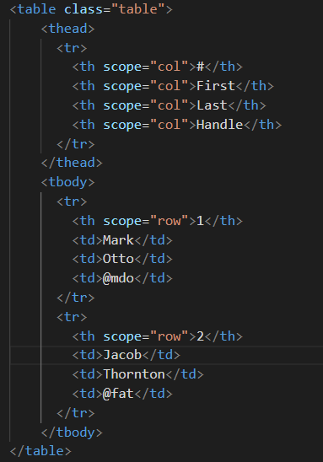
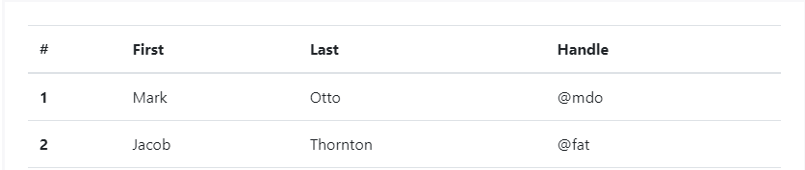
tableaux simples

Slide 10
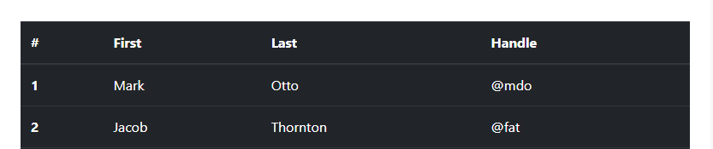
sombre tableaux

Slide 11
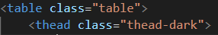
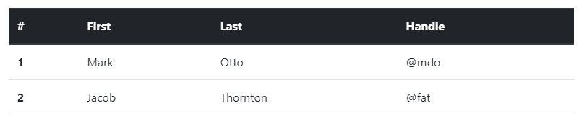
Table head options

Slide 12
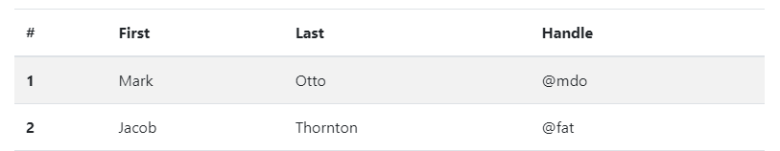
Striped rows

Slide 13
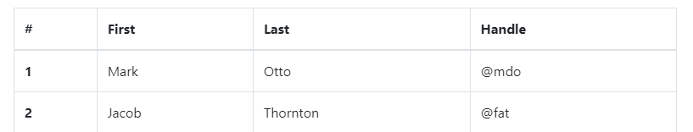
Bordered table

Slide 14
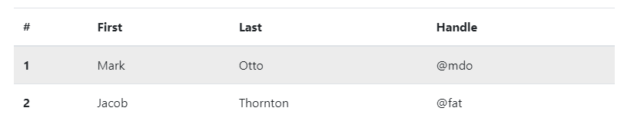
Hoverable rows

Slide 15
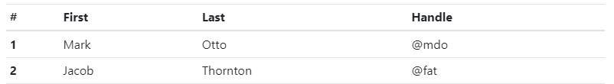
Small table

Slide 16
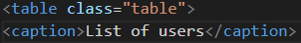
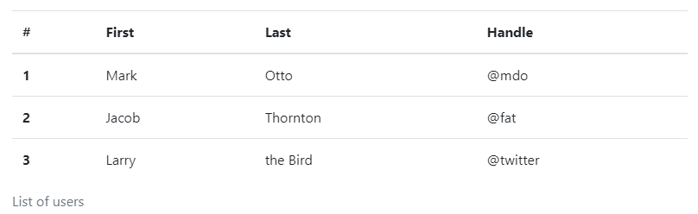
Captions

Slide 17
2 . Les classes contextuelles

Slide 18
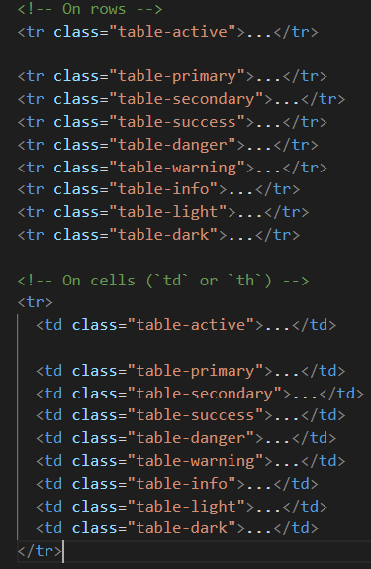
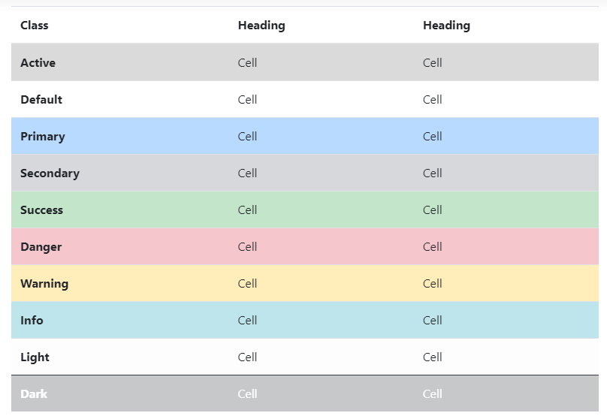

Slide 19
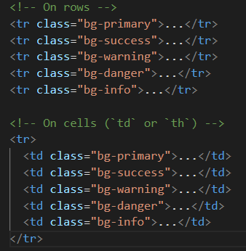
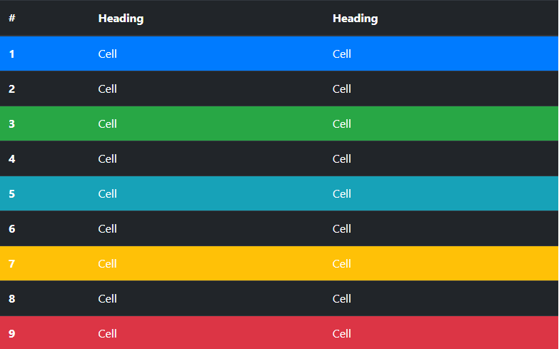

Slide 20
3 . Tableaux réactifs

Slide 21
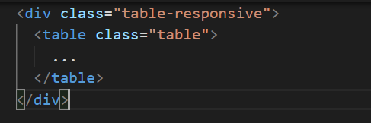
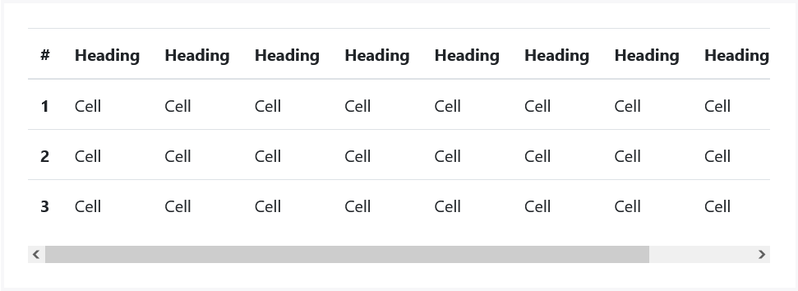

Slide 22
Liste

Slide 23
Objectif 2
Vous saurez capable de styler les Listes utilisent les classes Bootstrap.

Slide 24
1 . Exemple de base
01
02
Active items
Disabled items
03
04
Contextual classes
Flush

Slide 25
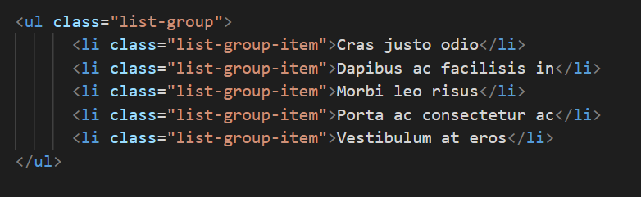
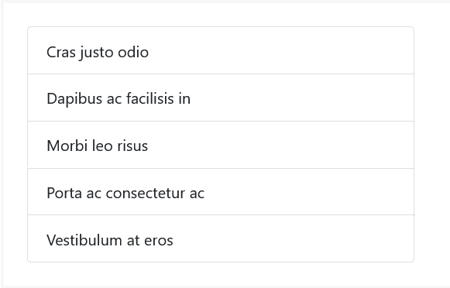
Liste simples

Slide 26
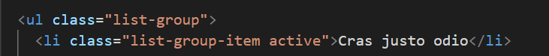
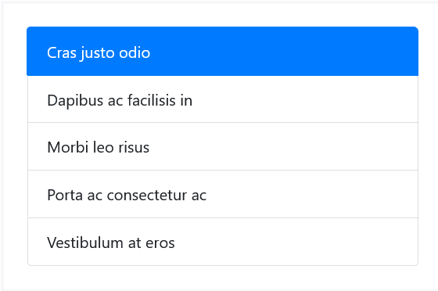
Active items

Slide 27
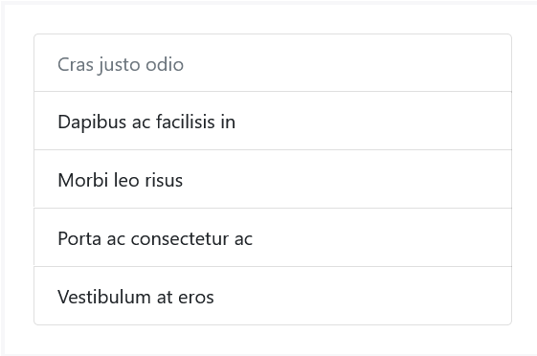
Disabled items

Slide 28
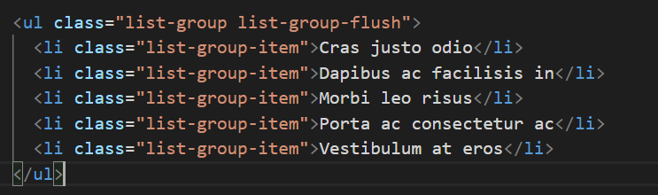
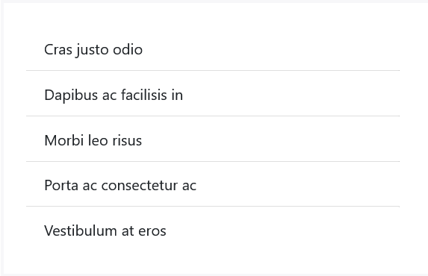
Flush

Slide 29
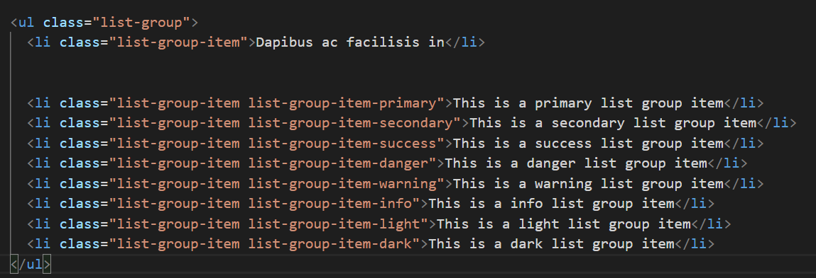
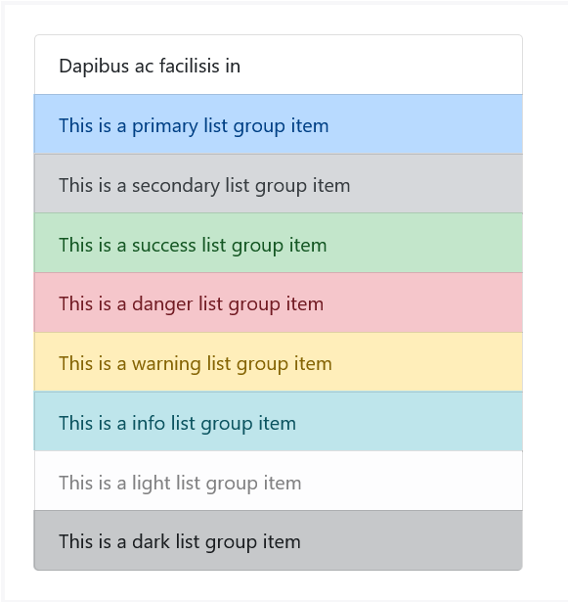
Contextual classes

Slide 30
2 . Les liens et les boutons

Slide 31
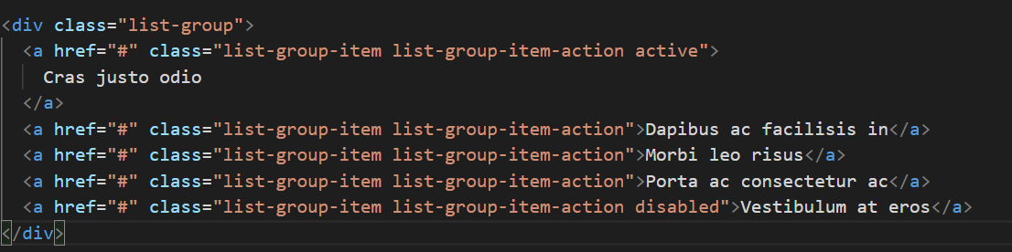
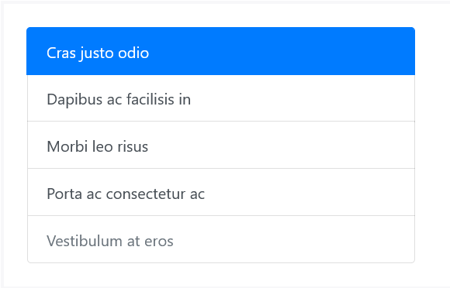
Links

Slide 32
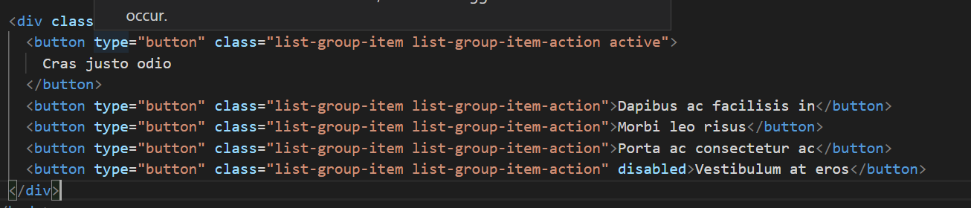
Buttons

Slide 33
Super!
Est ce que tu as des questions ?

Slide 34
Business web steps
Mercury is the closest planet to the Sun and the smallest
Programming
Step 1
Jupiter is a gas giant and the biggest planet
Step 2
Website
Java Script
Venus has a beautiful name and high temperatures
Step 3
Neptune is the farthest planet from the Sun
Design
Step 4

Slide 35
User profile
15%
10%
25%
15%
28%
78%
64%
25%
32%
22 - 30 years
25 - 40 years
50%

Slide 36
Monthly calendar
Meeting
Preview
Mon | Tue | Wed | Thu | Fri | Sat | Sun
 |  | 1 | 2 | 3 | 4 | 5
6 | 7 | 8 | 9 | 10 | 11 | 12
13 | 14 | 15 | 16 | 17 | 18 | 19
20 | 21 | 22 | 23 | 24 | 25 | 26
27 | 28 | 29 | 30
Neptune is very far from the Sun
Mars is actually a very cold place
Presentation
Deadline
Saturn is made of hydrogen and helium
The Earth is the planet where we live

Slide 37
User comments
”Neptune is the farthest planet from the Sun“
”The Earth is the planet where we all live“
”Despite being red, Mars is very cold“

Slide 38
06.
Conclusions
You can enter a subtitle here if you need it

Slide 39
Awesome words

Slide 40
Awesome words

Slide 41

Mobile web
You can replace the image on the screen with your own work. Just right-click on it and select “Replace image”

Slide 42
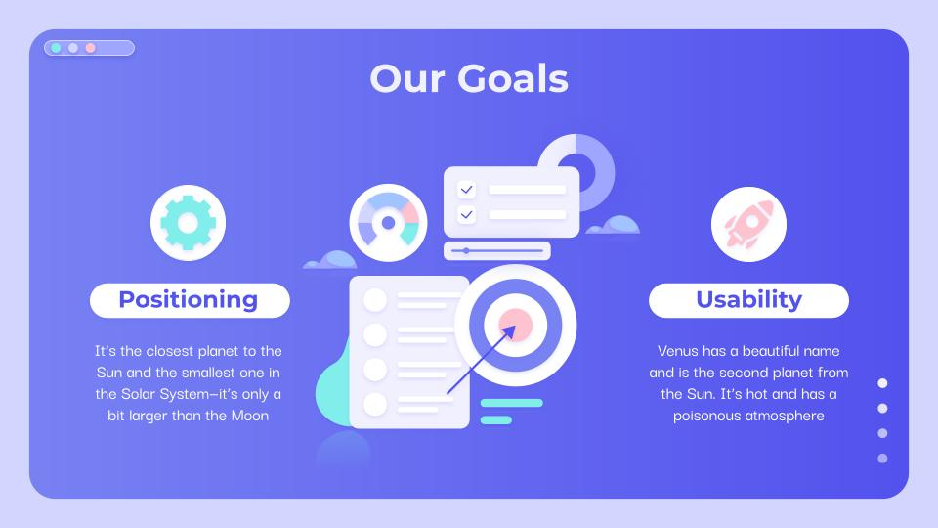
Tablet app
You can replace the image on the screen with your own work. Just right-click on it and select “Replace image”

Slide 43
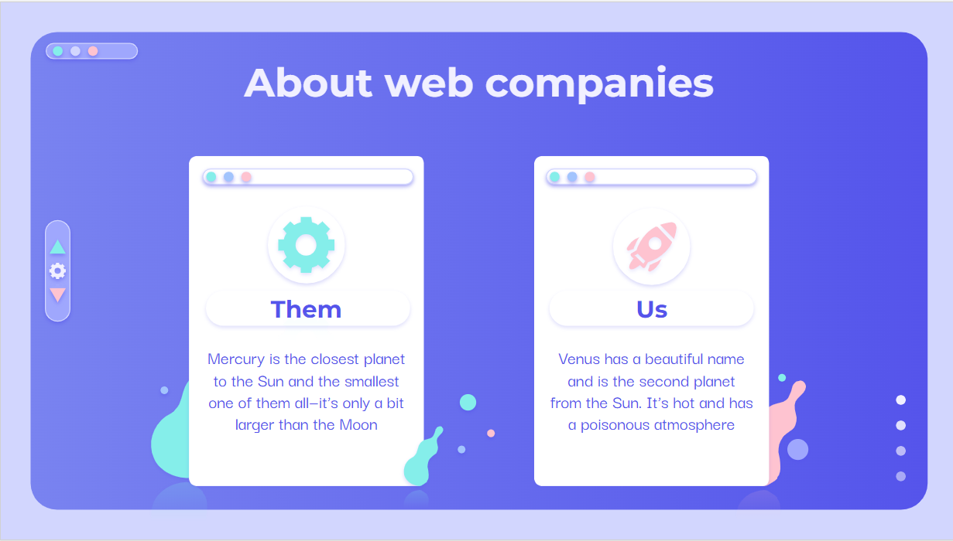
Desktop software
You can replace the image on the screen with your own work. Just right-click on it and select “Replace image”

Slide 44
Our team
Timmy Jimmy
Jenna Doe
Susan Bones
You can talk a bit about this person here
You can talk a bit about this person here
You can talk a bit about this person here

Slide 45


Our team
Sara Bones
Timmy Jimmy
You can talk a bit about this person here
You can talk a bit about this person here

Slide 46
Web-Design icon pack

Slide 47
Premium icon pack

Slide 48
Alternative resources
Here’s an assortment of alternative resources within the same style of this template

Slide 49
Premium alternative resources
Here’s an assortment of alternative resources within the same style of this template

Slide 50
Premium alternative infographics

Slide 51
Resources
Did you like the resources on this template? Get them for free at our other websites:
Photos
Businesspeople at office meeting
Business people meeting at office working
Icons
Icon Pack: Web Design
Vectors
Digital screens and plants 3d concepts landing page
Mobile phone interface 3d concepts landing page
Online purchases from home 3d concepts landing page
Social online interaction 3d concepts landing page
Monochrome violet 3d concepts landing page
Social media marketing landing page template
Strategy marketing landing page template
Connecting teams concept for landing page

Slide 52
Premium resources
Did you like the resources on this template? Get them at our other websites:
Photos
Medium shot business people working
Close up on young business team working
Smiling man with crossed arms
Confident happy young businesswoman sitting at office desk
Icons
Icon Pack: Web design
Vectors
Gradient ui/ux landing page
Gradient landing page with laptop and tools
Gradient landing page with tools
Data protection landing page
Start up landing page web design
Data protection landing page template
Data protection landing page I
Data protection landing page II
Flat design online marketing landing page

Slide 53
Instructions for use
In order to use this template, you must credit Slidesgo by keeping the Thanks slide.
You are allowed to:
- Modify this template.
- Use it for both personal and commercial projects.
You are not allowed to:
- Sublicense, sell or rent any of Slidesgo Content (or a modified version of Slidesgo Content).
- Distribute Slidesgo Content unless it has been expressly authorized by Slidesgo.
- Include Slidesgo Content in an online or offline database or file.
- Offer Slidesgo templates (or modified versions of Slidesgo templates) for download.
- Acquire the copyright of Slidesgo Content.
For more information about editing slides, please read our FAQs or visit Slidesgo School:
https://slidesgo.com/faqs and https://slidesgo.com/slidesgo-school

Slide 54
Fonts & colors used
This presentation has been made using the following fonts:
Montserrat
(https://fonts.google.com/specimen/Montserrat)
Darker Grotesque
(https://fonts.google.com/specimen/Darker+Grotesque)
#5352ee
#7882f3
#9ea6ff
#d2d6ff
#a1c3ff
#ffc3d0
#81eeeb
#3ae4df
#f1f0ff
#ffffffff

Slide 55





Storyset
Create your Story with our illustrated concepts. Choose the style you like the most, edit its colors, pick the background and layers you want to show and bring them to life with the animator panel! It will boost your presentation. Check out How it Works.
Pana
Amico
Bro
Rafiki
Cuate

Slide 56
Use our editable graphic resources...
You can easily resize these resources without losing quality. To change the color, just ungroup the resource and click on the object you want to change. Then, click on the paint bucket and select the color you want. Group the resource again when you’re done. You can also look for more infographics on Slidesgo.

Slide 59
JANUARY
FEBRUARY
MARCH
APRIL
MAY
JUNE
PHASE 1
Task 1
Task 2
PHASE 2
Task 1
Task 2
JANUARY
FEBRUARY
MARCH
APRIL
PHASE 1
Task 1
Task 2

Slide 62


